Slide 1
Data Mining Topic: Association Analysis
Dr. J Angel Arul Jothi
Department of Computer Science

Slide 2
Text Book Chapter 6
Sections 6.1, 6.2 and 6.3

Slide 3
Introduction
Business enterprises accumulate large quantities of data from their day-to-day operations
Example: huge amounts of customer purchase data
Market-Basket transactions
Each row corresponds to a transaction, which contains a unique identifier labeled TID and a set of items bought by a customer

Slide 4
Introduction
Retailers are interested in analyzing the data to learn about the purchase behavior of customers
Marketing promotions
Inventory management
Customer relationship management
Shelf management

Slide 5
Association Rule Mining
Association Analysis
Discovers interesting relationships hidden in large data
The uncovered relationships can be represented in the form of association rules
Market basket analysis
Given a set of transactions, find rules that will predict the occurrence of an item based on the occurrences of other items in the transaction
Example of Association Rules
{Diapers} → {Beer} {Milk, Bread} → {Eggs, Coke} {Beer, Bread} → {Milk}

Slide 6
Definition: Item set
Itemset
A collection of zero or more items
Example: {Milk} {Milk, Bread} {Milk, Bread, Diaper}
k-itemset
An itemset that contains k items
A transaction is said to contain an itemset X if X is a subset of the transaction
Support count of an itemset (σ)
Frequency of occurrence of an itemset
E.g. σ({Milk, Bread, Diaper}) = 2
E.g. σ({Milk, Bread}) = 3

Slide 7
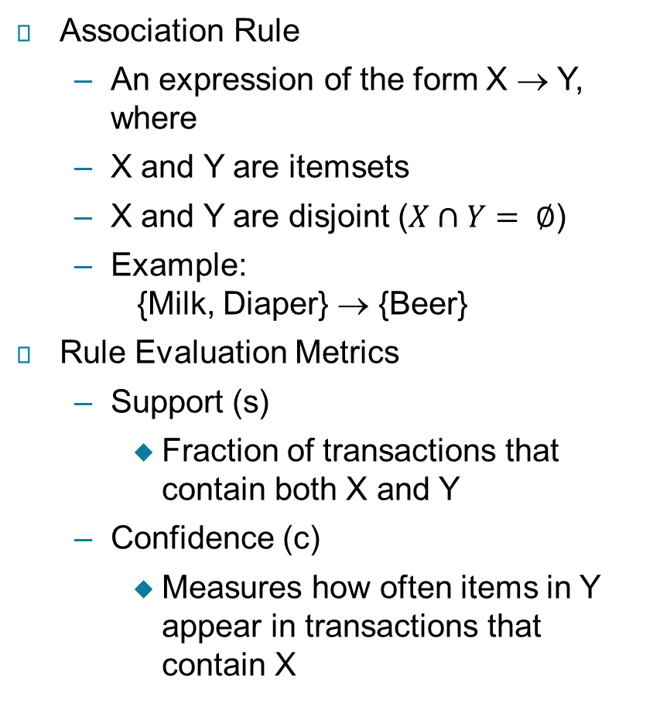

Definition: Association Rule

Slide 8
Example: Association Rule
Example:

Slide 9
Definition: Frequent Itemset
Frequent Itemset
An itemset whose support is greater than or equal to a minsup threshold

Slide 10
Association Rule Mining Task
Given a set of transactions T, the goal of association rule mining is to find all rules having
support ≥ minsup threshold
confidence ≥ minconf threshold
Brute-force approach:
List all possible association rules
Compute the support and confidence for each rule
Prune rules that fail the minsup and minconf thresholds
⇒ Computationally prohibitive!

Slide 11
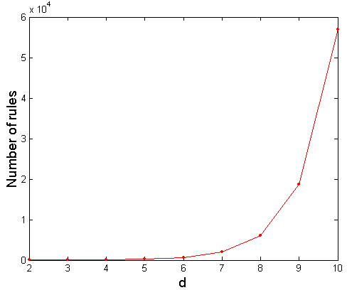
Computational complexity of brute force method
Given d unique items:
Total number of itemsets = 2^{d}
Total number of possible association rules:
If d=6, R = 602 rules

Slide 12
Mining Association Rules
Observations: All the above rules are binary partitions of the same itemset
Rules originating from the same itemset have identical support but can have different confidence
Support of a rule depends only on the support of its corresponding itemset
If the itemset is infrequent, then all candidate rules can be pruned immediately without having to compute their confidence values
Thus, we may decouple the support and confidence requirements
Itemset: {Beer, Diapers, Milk}
Example Rules:
{Milk, Diaper} → {Beer} (s=0.4, c=0.67) {Milk, Beer} → {Diaper} (s=0.4, c=1.0)
{Diaper, Beer} → {Milk} (s=0.4, c=0.67)
{Beer} → {Milk, Diaper} (s=0.4, c=0.67) {Diaper} → {Milk, Beer} (s=0.4, c=0.5)
{Milk} → {Diaper, Beer} (s=0.4, c=0.5)

Slide 13
Mining Association Rules
Two-step approach:
Frequent Itemset Generation
Generate all itemsets whose support ≥ minsup
Rule Generation
Generate high confidence (strong) rules from each frequent itemset, where each rule is a binary partitioning of a frequent itemset
Frequent itemset generation is still computationally expensive

Slide 14
Frequent Itemset Generation
Itemset lattice
Given d items, there are 2^{d} -1 possible candidate itemsets

Slide 15
Frequent Itemset Generation
Brute-force approach:
Each itemset in the lattice is a candidate frequent itemset
Count the support of each candidate by scanning the database
Match each transaction against every candidate
Complexity ~ O(NMw) => Expensive since M = 2^{d} -1!!!

Slide 16
Frequent Itemset Generation Strategies
Reduce the number of candidate itemsets (M)
Complete search: M=2^{d}
Use pruning techniques to reduce M
Reduce the number of comparisons (NM)
Use efficient data structures to store the candidates or transactions

Slide 17
Reducing Number of Candidates
Apriori principle:
If an itemset is frequent, then all of its subsets must also be frequent
Conversely, if an itemset is infrequent, then all of its supersets are also infrequent
The strategy of trimming the exponential search space based on the support measure is known as support-based pruning

Slide 18
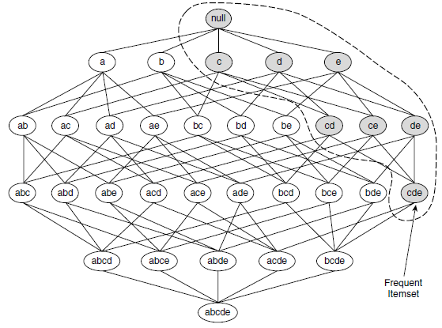
Illustrating Apriori Principle
Use of Apriori Principle
Support based pruning

Slide 19
Illustrating Apriori Principle
Use of Apriori Principle
Support based pruning
Found to be Infrequent
Pruned supersets

Slide 20

Reducing Number of Candidates
Monotonicity Property
Let I be a set of items, and J = 2^{I} be the power set of I
A measure f is monotone if X is a subset of Y, then f(X) must not exceed f(Y)
A measure f is anti-monotone if X is a subset of Y, then f(Y) must not exceed f(X)

Slide 21
Reducing Number of Candidates
Apriori principle holds due to the anti-monotone property of the support measure
Support of an itemset never exceeds the support of its subsets
This is known as the anti-monotone property of support

Slide 22
Frequent itemset generation - Apriori Algorithm
Apriori is the first association rule mining algorithm
Consider the transactions shown in the following table. Assume that the support threshold is 60%. Illustrate the frequent itemset generation using Apriori algorithm
Support threshold of 60% is equivalent to a minimum support threshold of 3

Slide 23
Frequent itemset generation - Apriori Algorithm
Step1:
Generate candidate 1-itemsets
Initially, every item is considered as a candidate 1-itemset
Identify the support count of each 1-itemset
Prune to get the frequent 1-itemsets
Eliminate the 1-itemset that does not satisfy minimum support

Slide 24
Frequent itemset generation - Apriori Algorithm
Prune 1-itemsets to get Frequent 1-itemsets
Candidate 1-itemsets

Slide 25
Frequent itemset generation - Apriori Algorithm
Step2:
Generate candidate 2-itemsets from frequent 1-itemset
Frequent 1-itemsets
Candidate 2-itemsets
No need to generate candidates involving Coke or Eggs

Slide 26
Frequent itemset generation -Apriori Algorithm
Identify the support of each 2-itemset
Eliminate the 2-itemset that does not satisfy minimum support - prune
Frequent 2-itemsets

Slide 27
Frequent itemset generation - Apriori Algorithm
Step3:
Generate candidate 3-itemsets from frequent 2-itemset
Frequent 2-itemsets
Candidate 3-itemsets

Slide 28
Frequent itemset generation - Apriori Algorithm
Identify the support of each 3-itemset
Eliminate the 3-itemset that does not satisfy minimum support - prune
Frequent 3-itemsets
Itemset | Count
{ Beer, Diaper, Milk} { Beer,Bread,Diaper} {Bread, Diaper, Milk} { Beer, Bread, Milk} | 2 2 3 1

Slide 29
Frequent itemset generation - Apriori Algorithm

Slide 30
Effectiveness of the Aprior pruning strategy
The number of candidate itemsets generated
Brute force method
Apriori principle
enumerating all itemsets (up to size 3) as candidates ⁶C₁ + ⁶C₂ + ⁶C₃
6 + 15 + 20 = 41
6 + 6 + 4 = 16

Slide 31
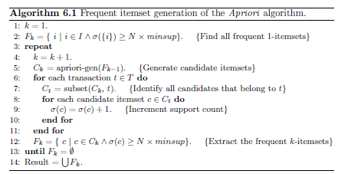
Apriori Algorithm
F_{k}: frequent k-itemsets
C_{k}: candidate k-itemsets

Slide 32
Apriori-gen() procedure
The apriori-gen(F_{k-1}) procedure performs two kinds of actions, namely, join and prune
Join is also called as candidate generation step
In the join step, F_{k-1} is joined with F_{k-1} to generate potential candidates
The prune component employs the Apriori property to remove candidates that have a subset that is not frequent

Slide 33
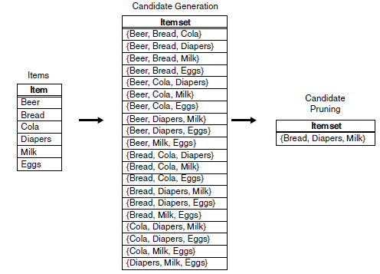
Candidate Generation: Brute-Force Method
Considers every k-itemset as a potential candidate
Then applies the candidate pruning step to remove any unnecessary candidates
The number of candidate itemsets generated at level k is equal to ^{d}C_{k} where d is the total number of items

Slide 34
Candidate Generation: F_{k-1} x F_{k-1} Method used by apriori-gen()
Merge two frequent (k-1)-itemsets if their first (k-2) items are identical

Slide 35
Candidate Generation: F_{k-1} x F_{k-1} Method
To eliminate duplicates
items in each frequent itemset are kept sorted in their lexicographic order
Each frequent (k−1)-itemset X is then extended with frequent (k−1)-itemset that are lexicographically larger than the items in X

Slide 36
Candidate Generation: F_{k-1} x F_{k-1} Method
Generate the candidate 4-itemset for the frequent 3-itemset given below
F₃ = {ABC, ABD, ABE, ACD, BCD, BDE, CDE}
Merge(ABC, ABD) = ABCD
Merge(ABC, ABE) = ABCE
Merge(ABD, ABE) = ABDE
Merge two frequent (k-1)-itemsets if their first (k-2) items are identical
Do not merge(ABD,ACD) because they share only prefix of length 1 instead of length 2

Slide 37
Apriori Algorithm with F_{k-1} x F_{k-1} Candidate Generation method
1-itemsets
2-itemsets
Minimum Support = 3
3-itemsets
If every subset is considered,
⁶C₁ + ⁶C₂ + ⁶C₃
6 + 15 + 20 = 41
With support-based pruning +
F_{k-1} x F_{k-1} Method,
6 + 6 + 1 = 13
Use of F_{k-1}xF_{k-1} method for candidate generation results in
only one 3-itemset.

Slide 38
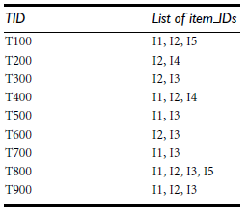
Example
Consider the following database D. illustrate the Apriori algorithm for finding frequent itemsets in D. Assume that the minimum support count required is 2.

Slide 39
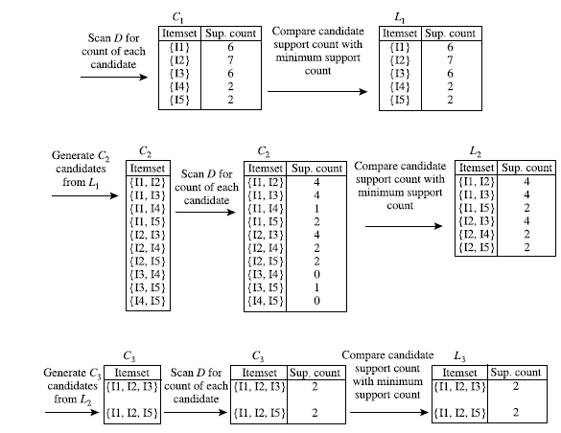
Example

Slide 40
Rule Generation
Given a frequent itemset Y, an association rule can be extracted by partitioning the itemset Y into two non-empty subsets, X and Y −X, such that X→ Y −X satisfies the confidence threshold
Note that all such rules must have already met the support threshold because they are generated from a frequent itemset
If |Y| = k, then there are 2^{k} – 2 candidate association rules (ignoring Y → ∅ and ∅ → Y)

Slide 41
Rule Generation
Y = {1, 2, 3} is a frequent itemset, find all candidate rules

Slide 42
Rule Generation
Consider the Transaction Dataset given below
If X = {Bread, Diaper, Milk} is a frequent itemset. What are the strong association rules that can be generated from X if the minimum confidence threshold is, say, 70%

Slide 43
Rule Generation
Frequent Itemset:{Bread, Diaper, Milk}
Form Rules:
{Bread, Diaper} → {Milk}; 3/4 = 0.75
{Bread, Milk} → {Diaper}; 3/3 = 1
{Diaper, Milk} → {Bread}; 3/4 = 0.75
{Bread} → {Diaper, Milk}; 3/4 = 0.75
{Diaper} → {Bread, Milk}; 3/5 = 0.6
{Milk} → {Bread, Diaper}; 3/4 = 0.75

Slide 44
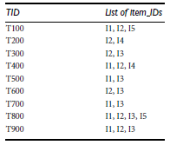
Rule Generation
Consider the Transaction Dataset given below
If X = {I1, I2, I5} is a frequent itemset. What are the association rules that can be generated from X if the minimum confidence threshold is, say, 70%

Slide 45
Rule Generation
X = {I1, I2, I5} is a frequent itemset

Slide 46
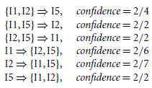
Rule Generation
Answer:
The second, third, and
last rules are output, because these are the strong rules (satisfy confidence threshold)
X = {I1, I2, I5} is a frequent itemset

Slide 47
Confidence-Based Pruning
Confidence of rules generated from the same itemset has an anti-monotone property
E.g., Suppose {A,B,C,D} is a frequent 4-itemset: c(ABC → D) ≥ c(AB → CD) ≥ c(A → BCD)
Confidence is anti-monotone w.r.t. number of items on the RHS of the rule

Slide 48
Rule Generation for Apriori Algorithm
Low Confidence Rule
Sub graph spanned by the node is pruned
Lattice of rules

Slide 49
Rule Generation
Answer:
Since the first rule’s confidence is less than the confidence threshold, rule 4 and 5 need not be generated at all !!
X = {I1, I2, I5} is a frequent itemset

Slide 50
Thank you

